Slide 1
Major Project Presentation
Name: Ritwik Kumar
Registration No: 209302292
Under Guidance: Mr. Virender Dehru

Slide 2
Introduction
I am currently interning at Cambridge Technology, a tech services company located in Hyderabad with over 20 years of experience. We specialize in guiding businesses through their digital transformation journey, offering expertise in building infrastructures and addressing various IT challenges. Our focus areas include AI, big data, and cloud solutions, where our team of experts assists clients in adopting the most suitable technological approaches to keep their businesses ahead in this rapidly evolving landscape. Within the Research and Development department, I am actively involved in Generative AI and Data Analysis. My role is to contribute to the development and advancement of innovative solutions, leveraging cutting-edge technologies to drive our commitment to excellence in the field of data science.

Slide 3
Learning Highlights
What is Generative AI:Generative AI enables users to quickly generate new content based on a variety of inputs. Inputs and outputs to these models can include text, images, sounds, animation, 3D models, or other types of data.
What are LLMS:A large language model (LLM) is a specialized type of artificial intelligence (AI) that has been trained on vast amounts of text to understand existing content and generate original content.
Frameworks : For making AI application we have majorly we have two frame works Langchain and Llama Index.

Slide 4

Motivation
1) Curiosity about AI:
Passion for Technology: A deep interest in artificial intelligence and its capabilities.
Innovative Potential: The desire to explore and utilize cutting-edge AI technologies.
2) Solving Real-world Problems:
Practical Applications: Aiming to develop solutions that address actual needs and challenges.
User Assistance: Creating tools that can help people efficiently interact with large volumes of information.

Slide 5
Objective
The primary objective of the Sacral (Doc Chat Bot) project is to develop an advanced document-based chatbot using the Retrieval-Augmented Generation (RAG) paradigm. This involves leveraging state-of-the-art AI technologies, including large language models (LLMs), the OpenAI API, and frameworks like Hugging Face, to create a robust and efficient system capable of accurately retrieving and generating relevant information from large datasets. The project aims to enhance practical AI applications by solving real-world problems, fostering continuous learning, and promoting ethical AI development through collaborative efforts. By integrating web scraping techniques and machine learning algorithms, the chatbot will provide precise and informative responses, thereby improving user interaction and data accessibility.

Slide 6
Technology Involved
Large Language Models (LLMs): In my project I have used open AI model specifically gpt 3.5 turbo.
Langchain Framework: I have used langchain framework.
Retrieval-Augmented Generation (RAG): Combines retrieval and generation techniques to enhance response accuracy.
Vector Database (Chroma DB): Used for storing the embeddings in the database so that futhur similarity search can be performed.

Slide 7
About OpenAI API and Its model
OpenAI API: The developer platform is a suite of services, including the above, that helps build and deploy AI applications
About GPT 3.5 turbo: The latest GPT-3.5 Turbo model with higher accuracy at responding in requested formats and a fix for a bug which caused a text encoding issue for non-English language function calls. Returns a maximum of 4,096 output tokens.

Slide 8
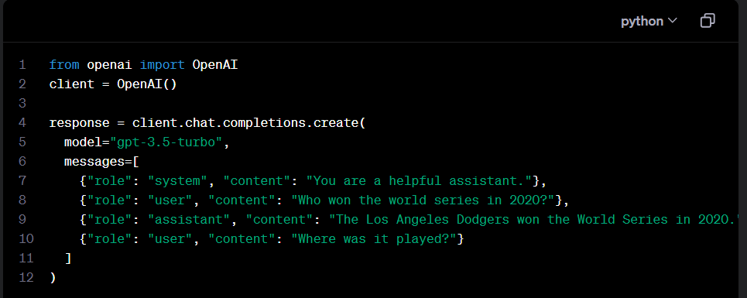
Chat Completions API
Chat models take a list of messages as input and return a model-generated message as output. Although the chat format is designed to make multi-turn conversations easy, it’s just as useful for single-turn tasks without any conversation.

Slide 9
Langchain
LangChain is a framework for developing applications powered by language models. It enables applications that:
Are context-aware: connect a language model to sources of context (prompt instructions, few shot examples, content to ground its response in, etc.)
Reason: rely on a language model to reason (about how to answer based on provided context, what actions to take, etc.)

Slide 10
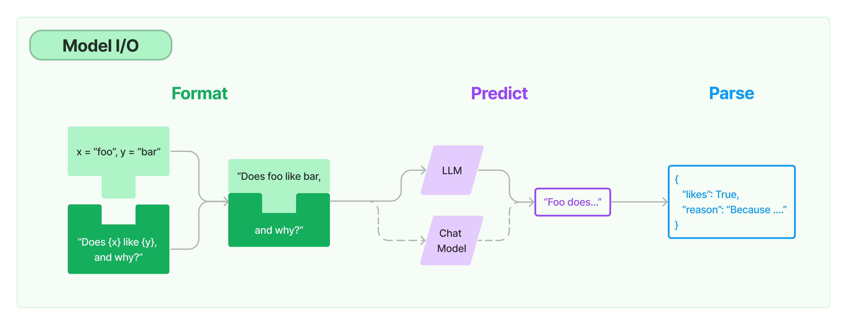
Modules
Model I/O: The core element of any language model application is...the model. LangChain gives you the building blocks to interface with any language model.

Slide 11
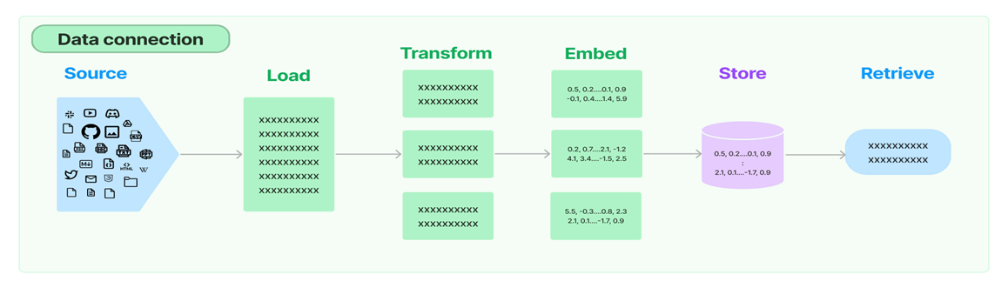
About Retrieval-Augmented Generation
Retrieval: Many LLM applications require user-specific data that is not part of the model's training set. The primary way of accomplishing this is through Retrieval Augmented Generation (RAG). In this process, external data is retrieved and then passed to the LLM when doing the generation step.

Slide 12
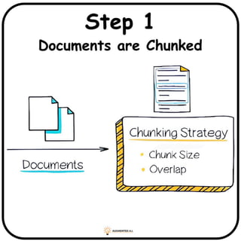
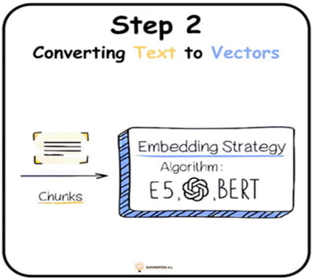
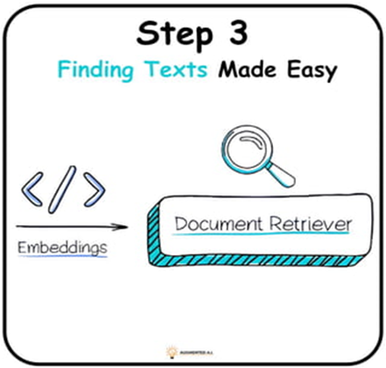
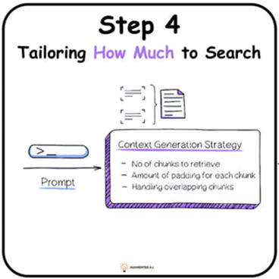
Explanation with diagram

Slide 13
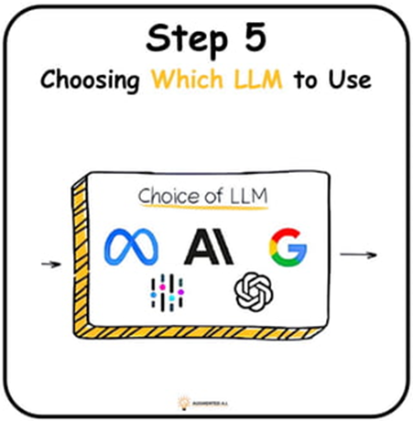
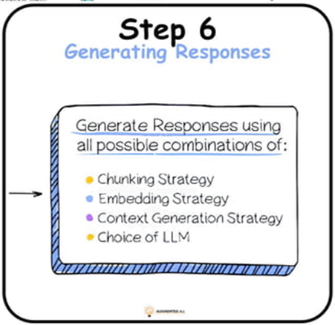
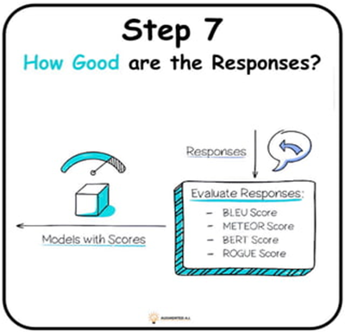
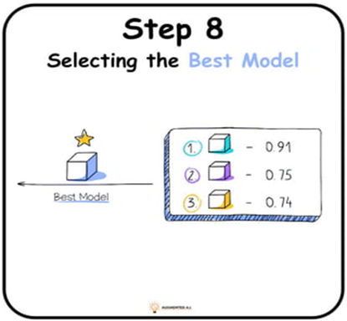
Continued..

Slide 14

Doc Chat Bot
Three major technologies have been utilized in the backend: OpenAI model GPT 3.5 turbo, LangChain, and ChromaDB. The primary function of this application is to enable users to upload their own documents. Using prompts, they can then ask questions related to their documents and receive answers accordingly.

Slide 15
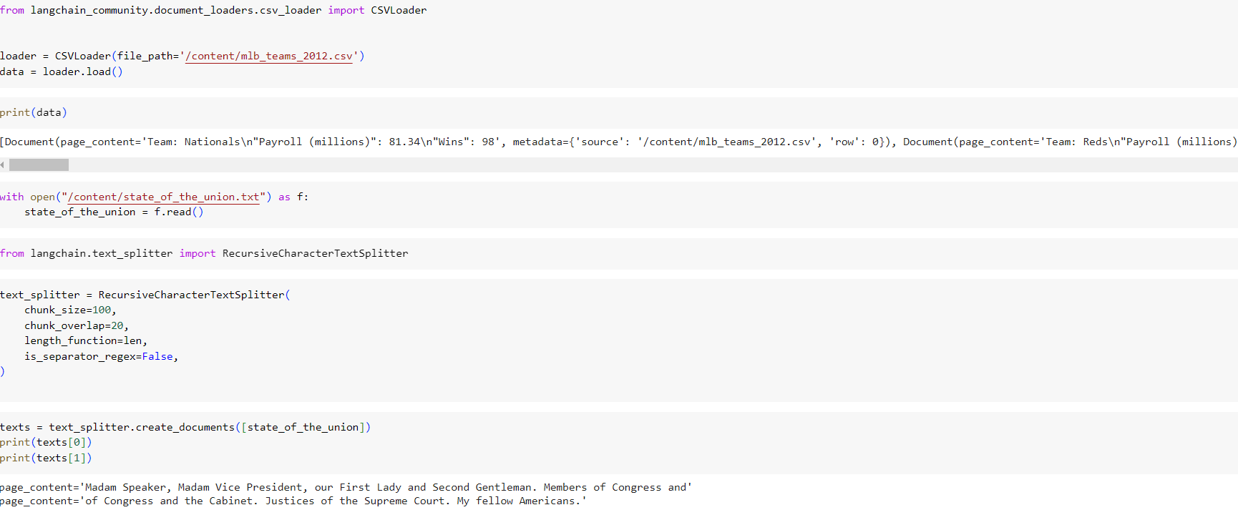
Document loader and Text splitter

Slide 16
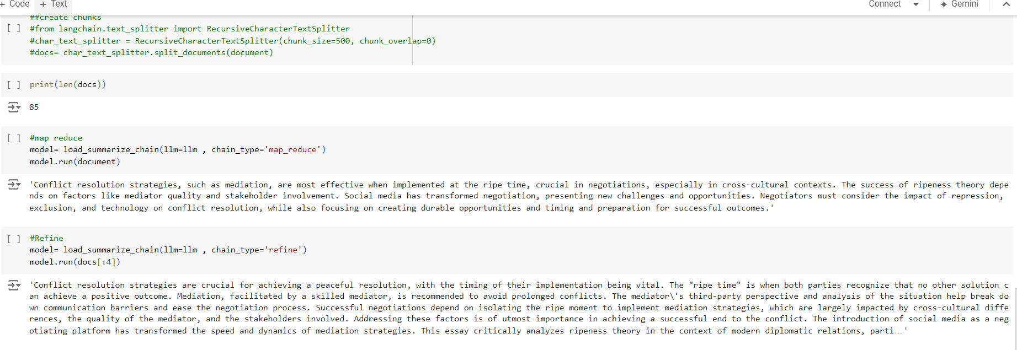
Chunks and summarization

Slide 17
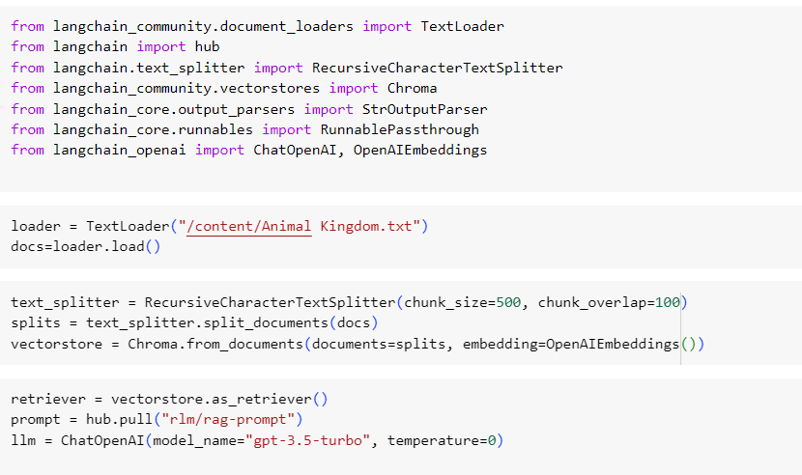
Vector store And Embeddings

Slide 18
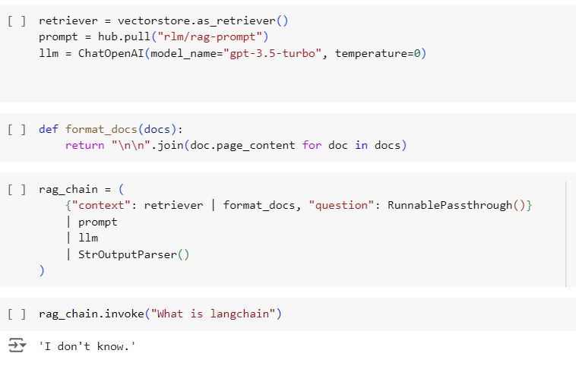
Chains and Retriever

Slide 19
Conclusion
In conclusion, the Sacral (Doc Chat Bot) project successfully demonstrates the potential of integrating advanced AI technologies to create a robust and efficient document-based chatbot. By leveraging Large Language Models (LLMs), the OpenAI API, and Hugging Face frameworks, the project has achieved significant advancements in natural language understanding and generation. The incorporation of web scraping techniques ensures comprehensive data access, while the Retrieval-Augmented Generation (RAG) paradigm and Chroma DB enhance response accuracy and efficiency. Implemented with Python and supported by NumPy for numerical computations, this project not only addresses real-world problems but also exemplifies the importance of continuous learning and ethical AI development. The collaborative effort and innovative approach set a strong foundation for future enhancements and applications in various domains.

Slide 20
Thank you

